Slide 1
Convolution Network
邱弘毅 卓泉源

Slide 2
Convolution

Slide 3
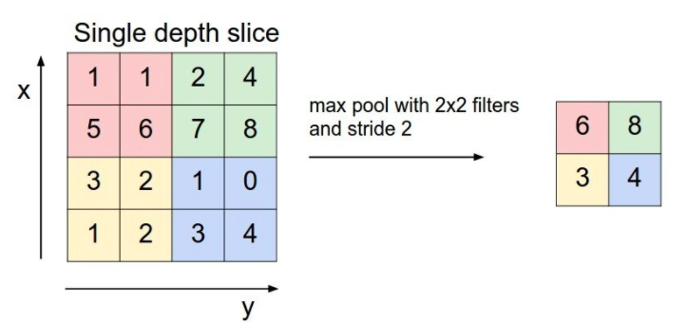
Max pool

Slide 4
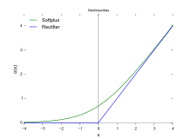
Activation function

Slide 5
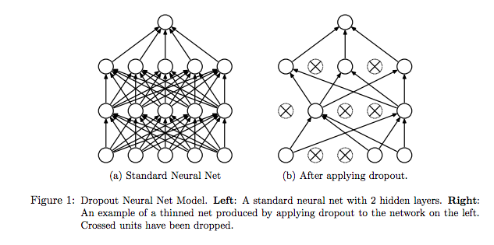
Dropout

Slide 6
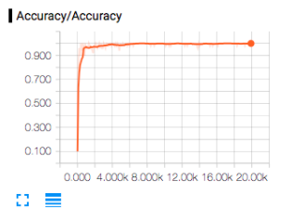
Tensorboard
tensorboard ––logdir=’directory’

Slide 7
Today’s structure 1
Layer1
Input dimension (28*28)
conv layer (feature size: 32, filter: 5*5), stride = 1
RELU activation function
2*2 max pooling, stride = 2
Layer 2
Input dimension (14*14)
conv layer (feature size: 64, filter: 5*5), stride = 1
RELU activation function
2*2 max pooling, stride = 2
Layer 3
Input dimension (7*7)
Fully connected
Output Dimension 1024
RELU activation function
Layer 4
Dropout (keep prob = 0.5)
Layer 5
Input dimension 1024
Fully connected
Output Dimension 10

Slide 8
Today’s structure 2
Loss: cross_entropy (tf.nn.softmax_cross_entropy_with_logits)
Optimizer: Adam
Learn rate: 1e-4

Slide 9
ref
http://bit.ly/2A2vsrL
http://bit.ly/2A4oqmC

